Slide 1

Saturated Absorption Spectroscopy
Anthony Plechacek
Luzando Mukubu

Slide 2
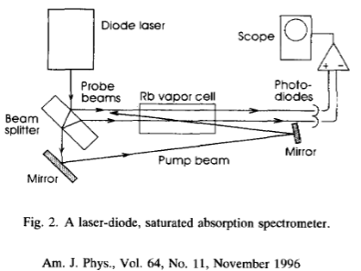
Refresher

Slide 3
Experiment Update
Aligned diffraction grating
Looking into spectrometer

Slide 4
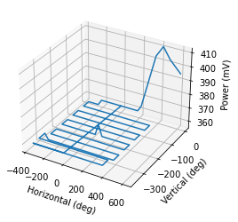
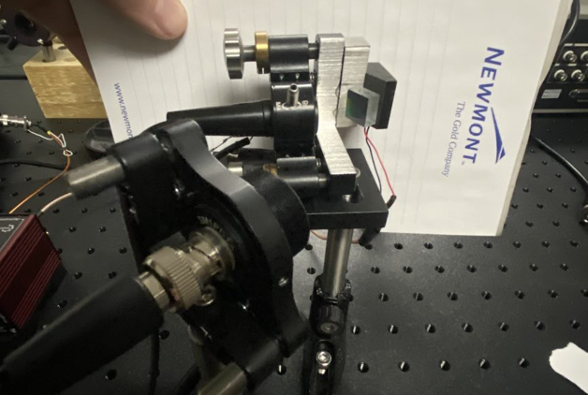

Aligned Diffraction Grating

Slide 5
Tragedy Strikes

Slide 6
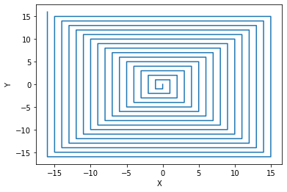
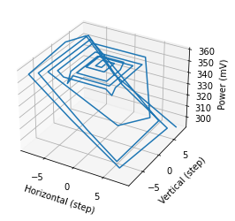
Diffraction Grating: Moving Forward
Tighten Setup
New Pattern

Slide 7
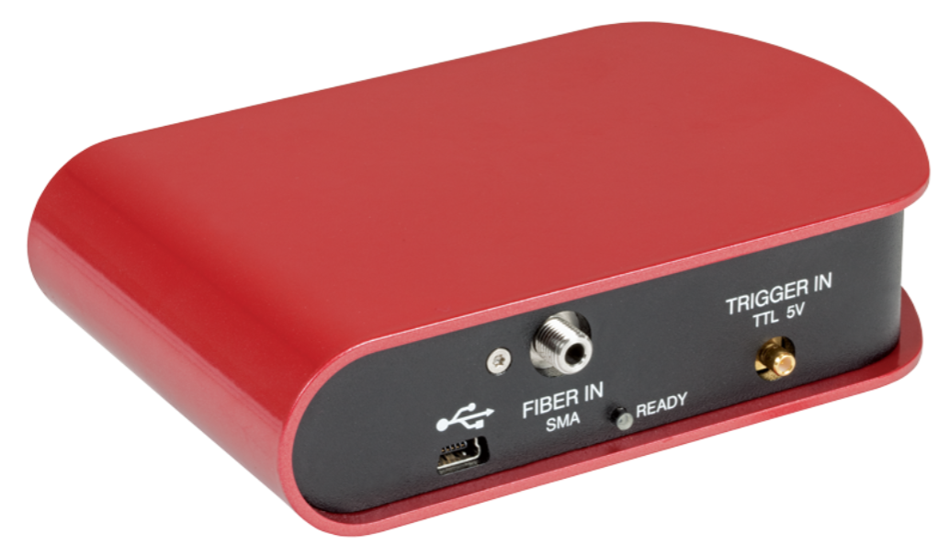
Spectrometer
350 nm - 700 nm

Slide 8

Questions

